Slide 1
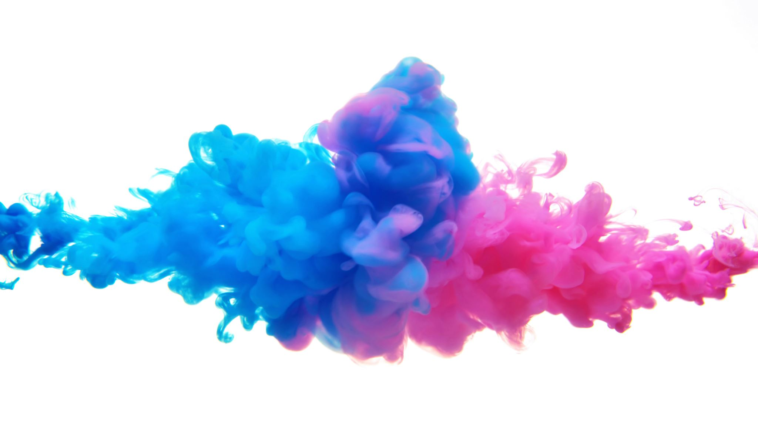
Ist2111 Project
Mia Paulin
South University
IST2111: Multimedia Web Design
Professor Bishop
9/26/2023

Slide 2
Questions to ask Client
Customer demographics:
What are the demograpchic of the customers?(age/family/singles/couples/young people)
What are their interest?(arts/entertainment/history/music/shopping)
Customer Packages
If more that one demographic, do you want to offer more packages
Included in packages
Are hitel stays included
Are tour groups included for site seeing

Slide 3
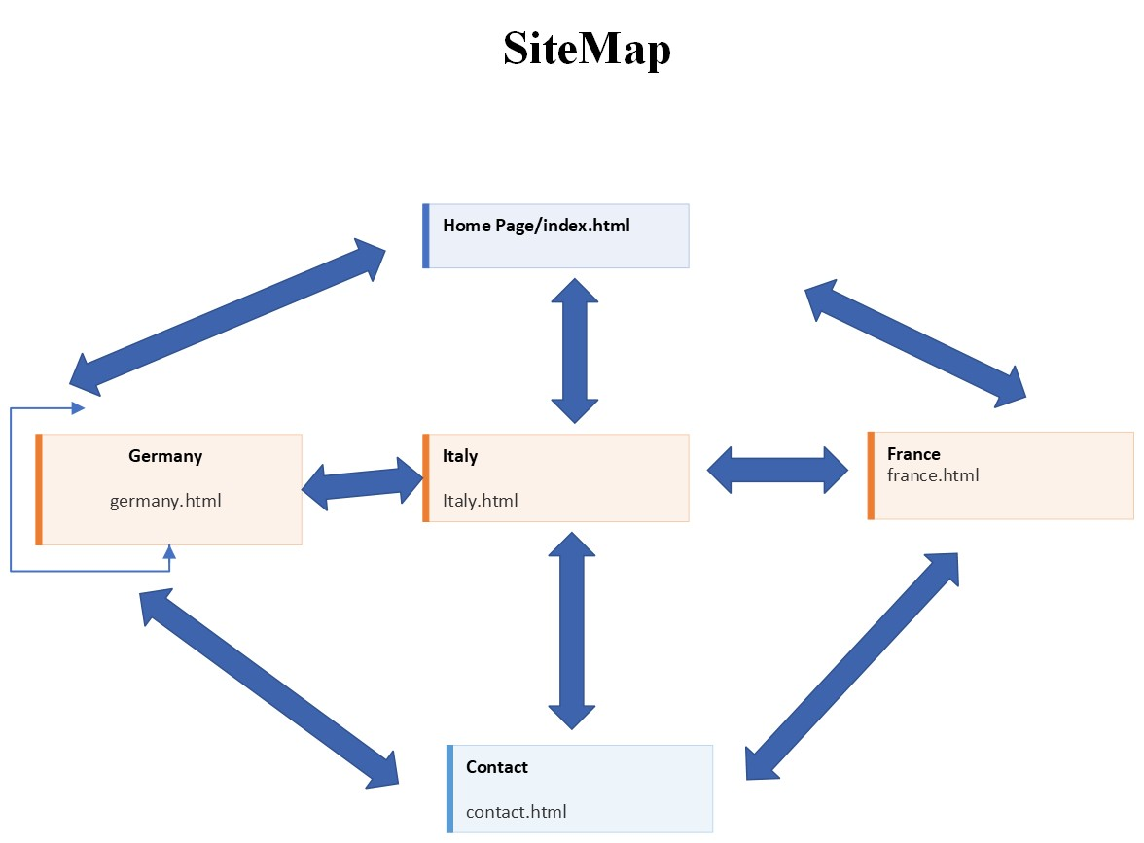
sitemap

Slide 4
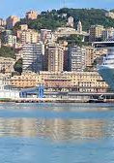
home Page the following is the text portion of the homepage/index.html:
Express Holidays
This is you entrance to the rest of the world. Discover adventures like you’ve never done before. Cruise the waterways of the world on one of our extraordinary cruise lines and dock in a beautiful locale, whether Venetian ports during day break, France in the spring time, or regal German cities.
Express Holidays tourism and travel meet the needs and accommodations of anyone wanting to live the horizons that cover our Earth. There are travel packages for families, those who want to experience romance and escape on their honeymoon, or young adventures first setting out to explore the world

Slide 5
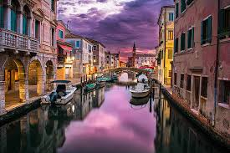
ItAly
Express Holidays offers Italy’s finest. Experiences from restaurants with exquite dining experiences to famous Italian cruisine. Dine on Bottarga, or Sicilian Caviar, Bistecca Fiorentina, which is Fiorentina Steak, or Ossobuco alla Milanese, or bone-in-veal shank.
Visit monument like the Vatican. See where mere men fought roaring beast in the Colosseum. Ride through the canals of Venice. Enjoy the art of the Sistene Chapel.
Strut with designs of the catwalk from iconic shopping districts Piazza delle Erbe, Pallazzo Boromeo and Mercarti di Rialto.

Slide 6
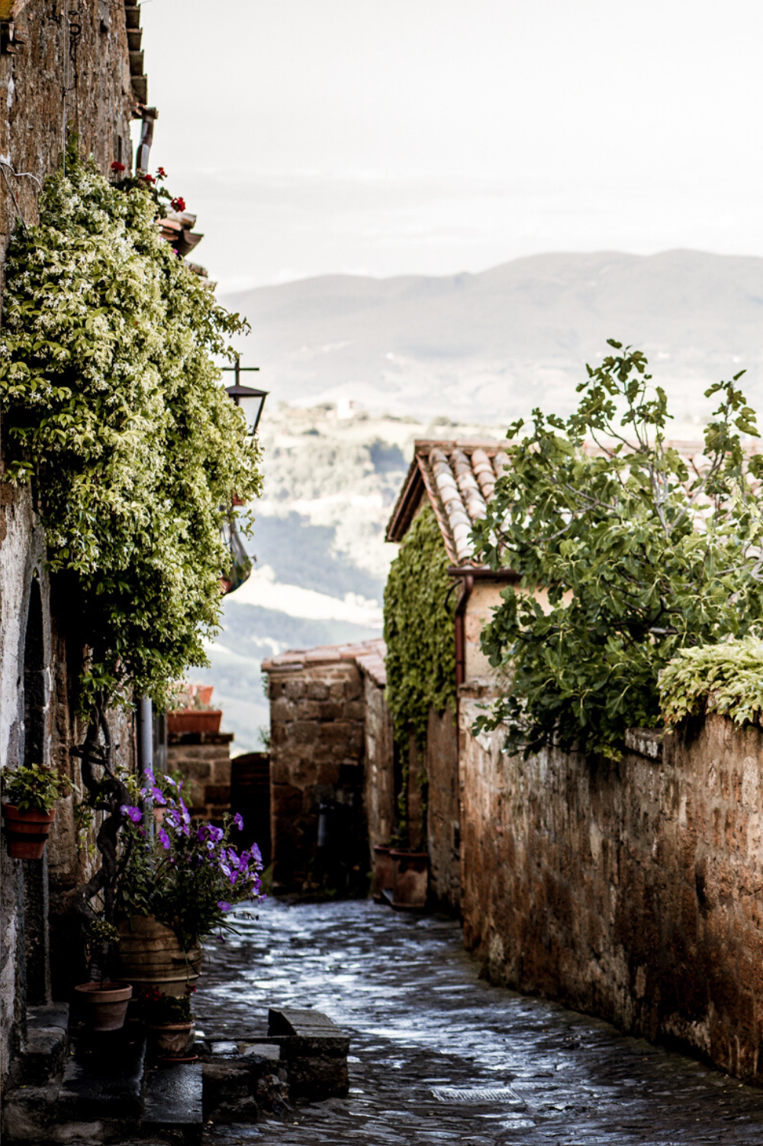
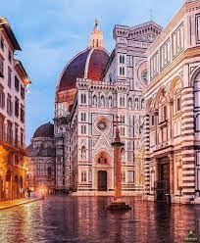
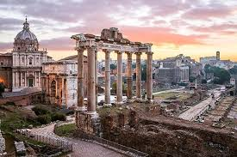
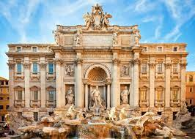
Media for Italy: pictures

Slide 7
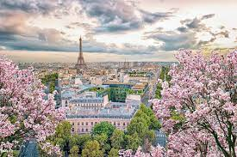
France
Express Holidays introduces France: this mean Escargo, Bagets and Crepes. A place where the vineyards and wineries never stop. Venture from the Ival Tower to French Catherals to Cannes and other beaches for which to sunbath on.
Gear up in fashion districts like Haussman-opera-saint-Lazare Marais and Martyrs-Pigalle. Then flaunt them at the Cannes Film Festival, Paris Fashion Week or Cirque De Soliel.

Slide 8
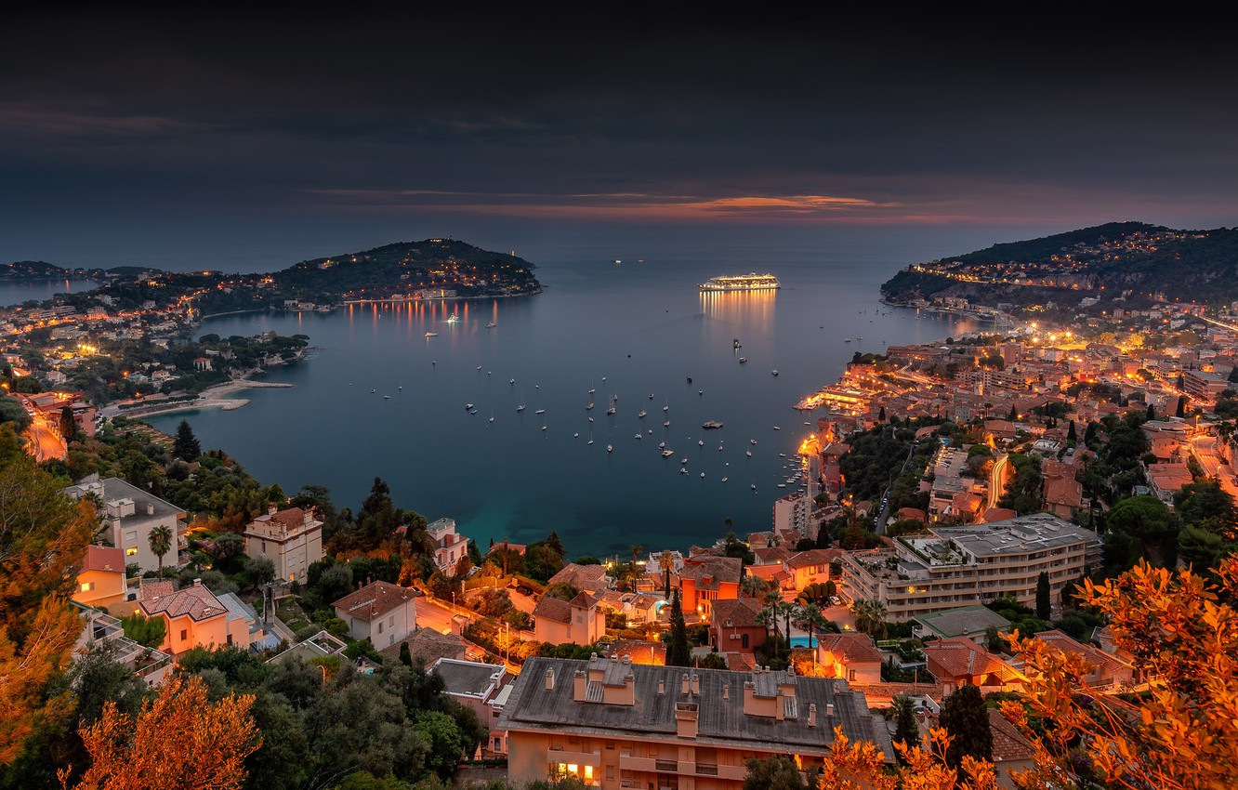
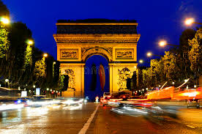
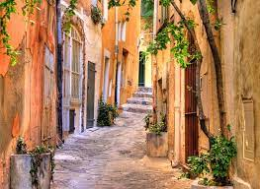
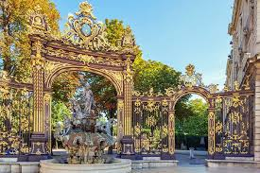
Media for France: Pictures

Slide 9
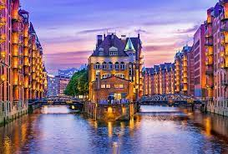
Germany
Express Holidays bring you to the Arts with a German Flare. Cinematograpghy comes to life at the Berlinale Film Festival in Berlin and music inspired by a legend echoes German culture at Reeperbahn Festival in Hamburg. Become a part of the culture at Karnerval Cologne.
Visit beautiful, breathetaking landmarks like Cologne Catherdral and Neuschwanstein Castle. Relive German history at Historic monuments like the Brandenburg Gate.

Slide 10
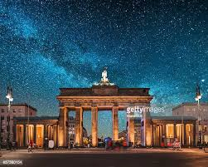
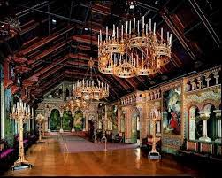
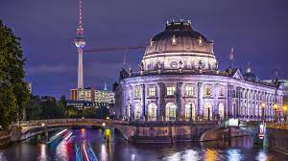
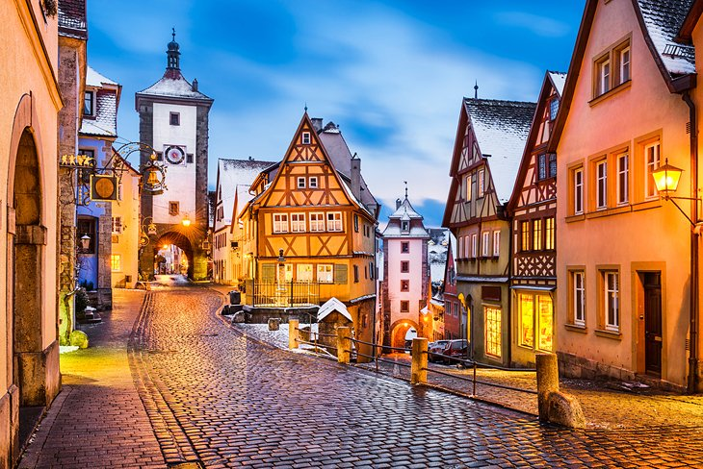
Media for Germany: Pictures

Slide 11
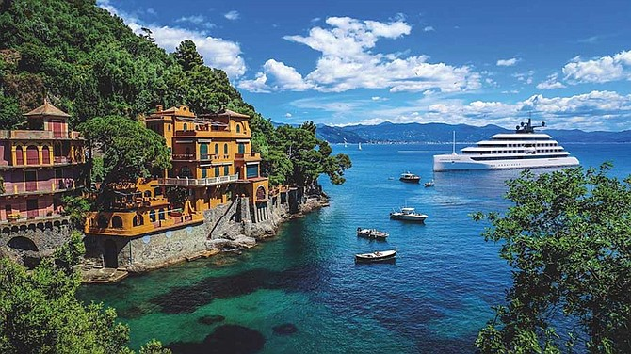
Contact

Slide 12
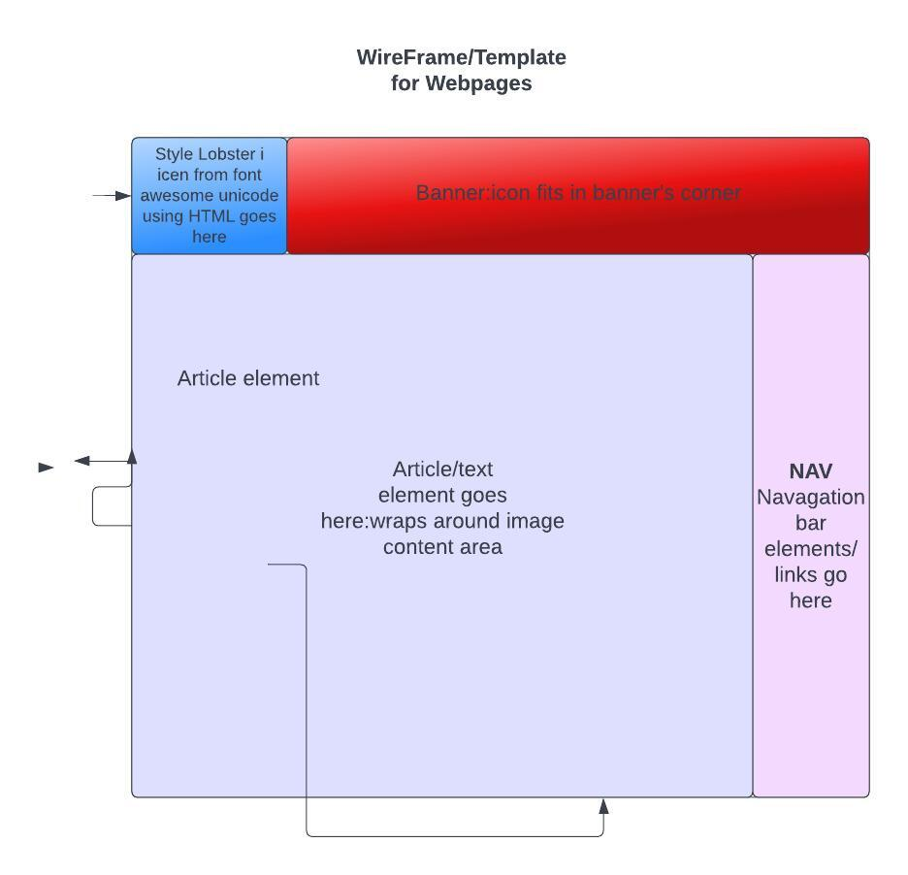
WireFrame/Template for webpages
Logo is a Lobster icon that will be implement in the top left hand corner of the banner using the following HTML: &#e421;

Slide 13
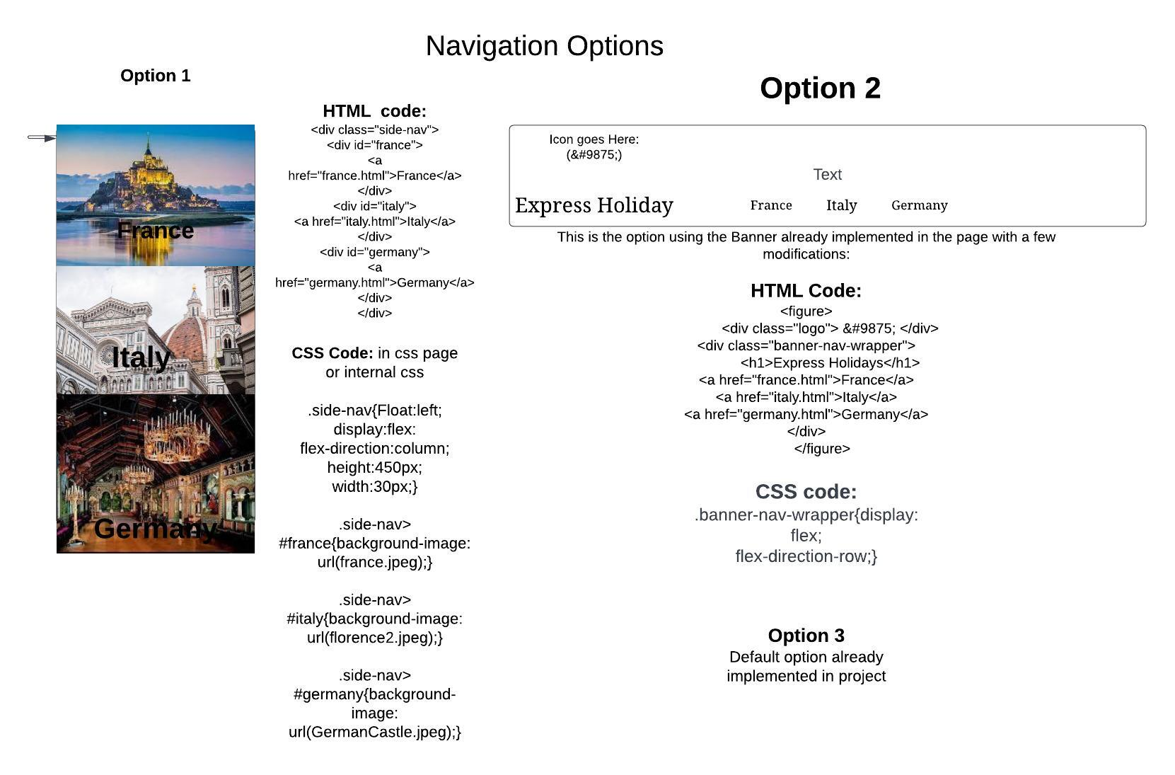

Slide 14
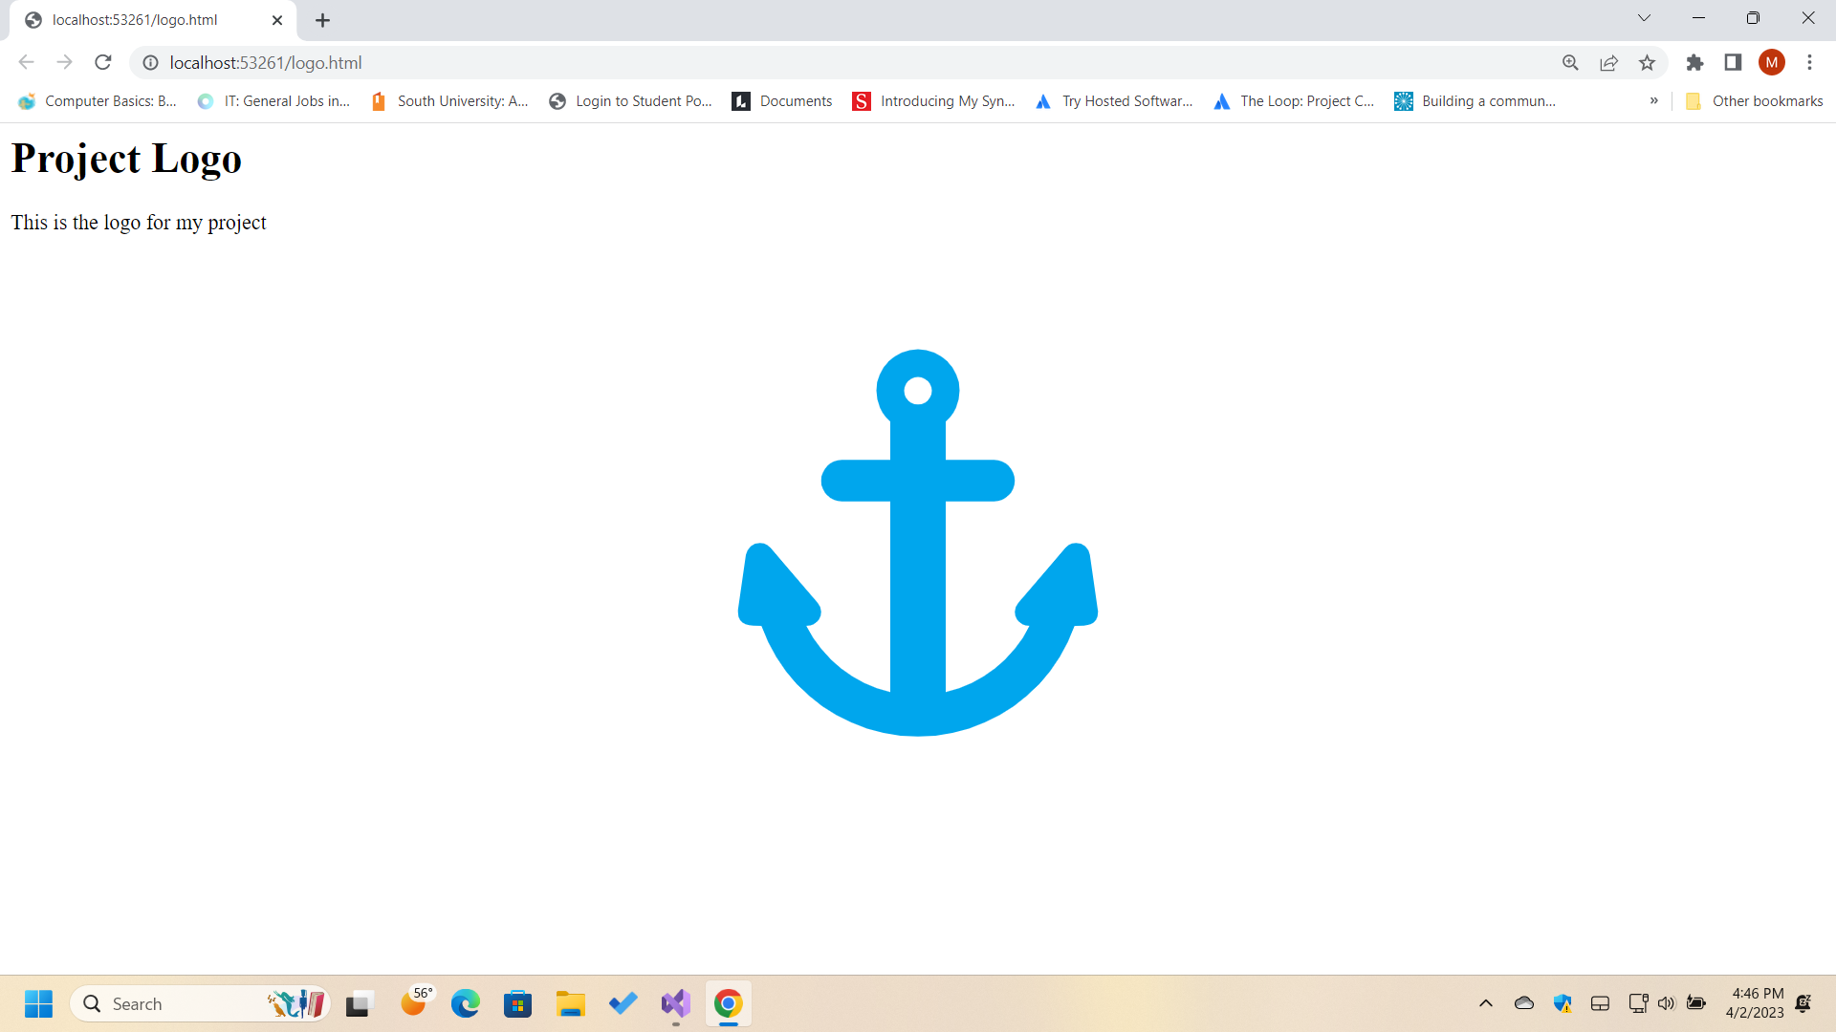
Website Logo

Slide 15
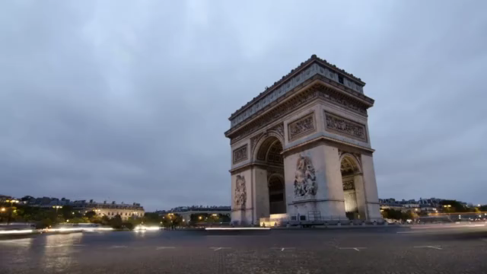
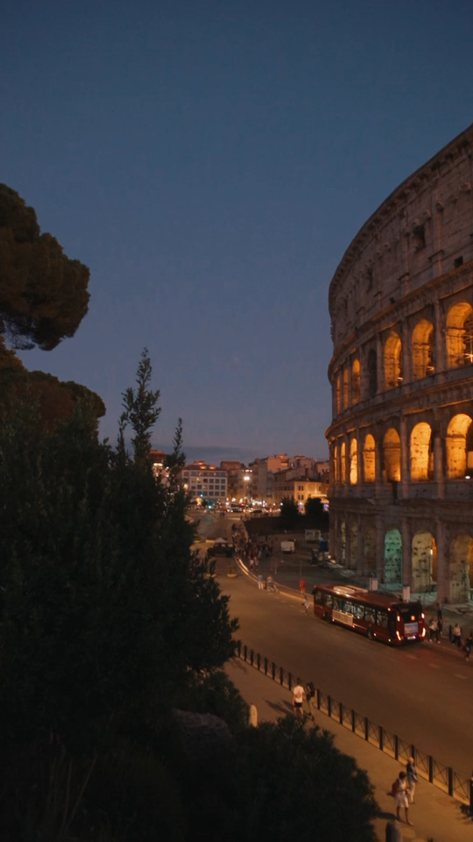
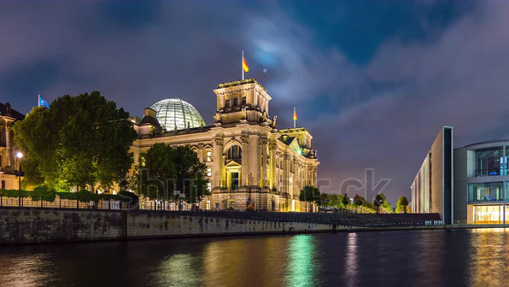
Video Clips and embedded code
Paris/ France
Rome/Italy
Berlin/ Germany
<video width:”” height:”” autoplay>
<source src=”distillParis.mp4” type=”video/mp4”>
<source src=” distillParis.ogg” type=”video/ogg>
</video>
<video width:”33px” height:”31px” autoplay>
<source src=”Romes-collesum.mp4” type=”video/mp4”>
<source src=”Romes-colleusm.ogg” type=”video.ogg>
</video>
<video width:”30px” height:”20px” autoplay>
<source src=”berlin.webm” type=”video/type”>
<source src=”berlin.ogg” type=”video/ogg>
</video>

Slide 16

Audio File/Water Running
Water running is the option I chose because the main point of transportation in the company is a cruise ship. Also, most all of my destination pages- along with my homepage- have water in the background image. Tap on the image to hear the file.

Slide 17
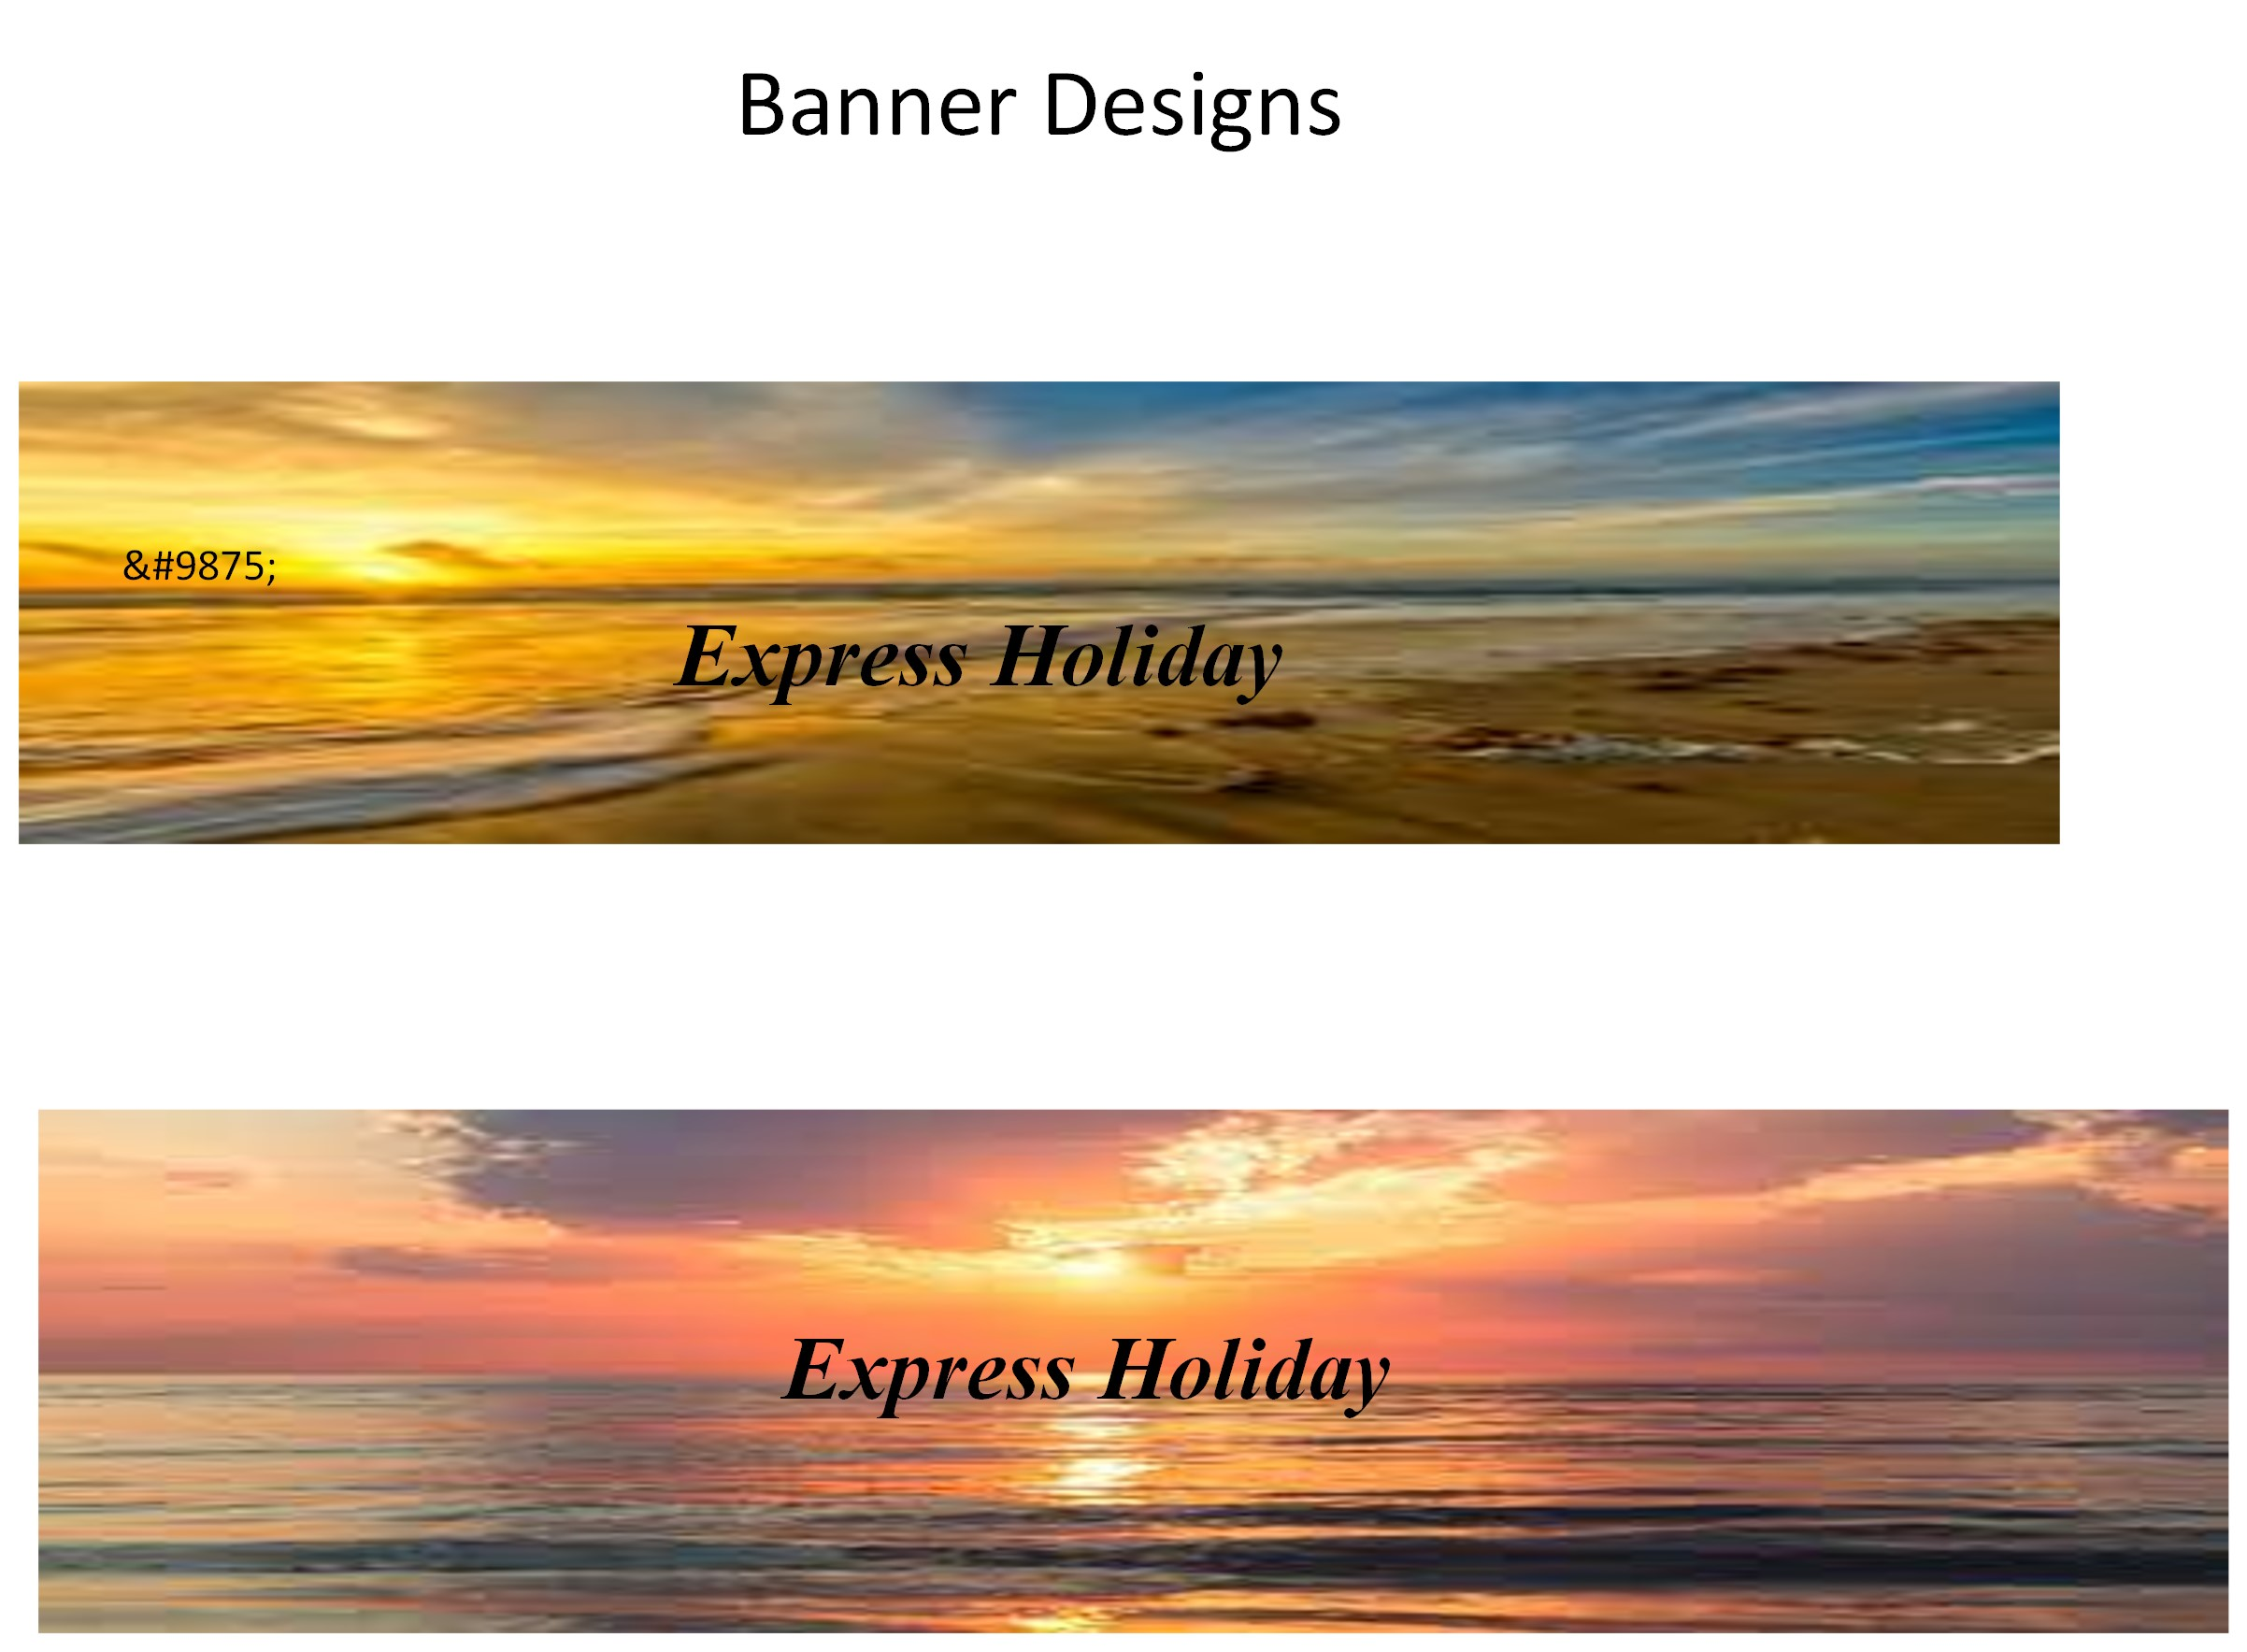
Banner Designs

Slide 18
References
Avans, M.(2023). a-scenic-view-of-the-colosseum-in-rome. Pexels.com. https://www.pexels.com /video/a-scenic-view-of-the-colosseum-in-rome-5087349/
Distill.(2023). arc-de-triomphe-in-paris. Pexels.com. https://www.pexels.com/video/arc-de-
triomphe-in-paris-852352/
Emmanuelle.(2023). Water Waves on a Beach with Wind. Pixabay.com. https://pixabay.com/sound-
effects/search/waves/
Ricooder.(2023). Night to Day Hyper Lapse of Reichstag Building with Spree River, Berlin,
Germany. ShutterStock.com. https://www.shutterstock.com/video/clip-1060205663-
night-day-hyper-lapse-reichstag-building-spree

